Slide 1


Term Project 2
Capacitive Displacement System
Ahmet Arif Tezgel
200027037
Emir Ayar 200030473

Slide 2
Introduction to System
1
Contents
System Overview and System Calculations
2
Parameters
3
4
Simulation and results
5
Questions

Slide 3
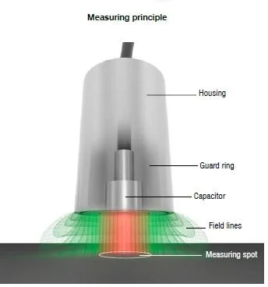
Introduction to System
Capacitive displacement systems play a critical role in modern industrial automation and precision measurement applications. Capacitive displacement systems provide efficient solutions to position measurement needs that require high precision and accuracy.
Based on electric field principles, capacitive displacement sensors provide both high reliability and superior performance in harsh operating environments thanks to their non-contact measurement capabilities. In this paper, the basic working principles, application areas and advantages of capacitive displacement systems will be discussed in detail. It will also shed light on the increasing importance of this technology in today's industrial processes and its potential future applications.

Slide 4
Introduction to System
The capacitive displacement system can be used in the
industry as follows:
1. Sensor Technologies
Capacitive displacement systems are widely used for
measuring small mechanical movements. This system is
especially preferred in situations where high precision is
required. Example areas of use:
Industrial Automation: Sensing and controlling micron-level movements of machine parts.
Robotics: Measuring precise movements of robot arms and providing feedback.
Medical Devices: Motion sensing in magnetic resonance
(MRI) devices or surgical robots.
2. Micro-Electro-Mechanical Systems (MEMS)
MEMS devices contain electromechanical systems with small dimensions. Capacitive displacement sensors are commonly used in such devices:
Accelerometers: Accelerometers used in the automotive and aerospace industries.
Pressure Sensors: Systems used to measure air pressure or gas pressure.
Micro-Actuators: Microscale motion mechanisms that require precise position control.
3. Electromechanical Energy Conversion
The energy storage properties of capacitors allow this system to be used in energy conversion:
Piezoelectric Energy Harvesting: Conversion of mechanical vibrations into electrical energy.
Renewable Energy Systems: Capacitive displacement
measurement in wind turbines or vibrating energy harvesting systems.

Slide 5
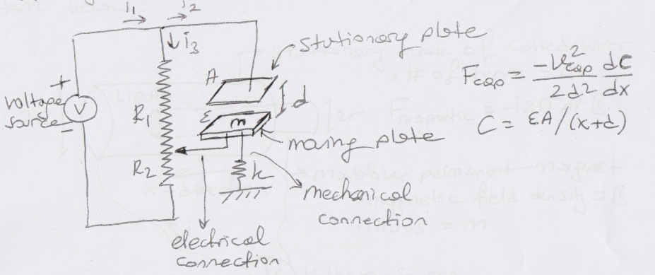
System Overview and System Calculations
Capacitive Displacement System merges mechanical and electrical components to measure and control the displacement of a moving plate.
The system needs to be analyzed in 2 parts. These parts can be called the dynamic and electrical parts of the system. The first part is the dynamic part of the system. The second part is the electrical part.
System includes 3 components:
Spring-mass mechanism
Variable parallel plate capacitor
Electric circuit
Figure 1. Model on paper of the capacitive displacement
system given to us in the reference sheet.

Slide 6

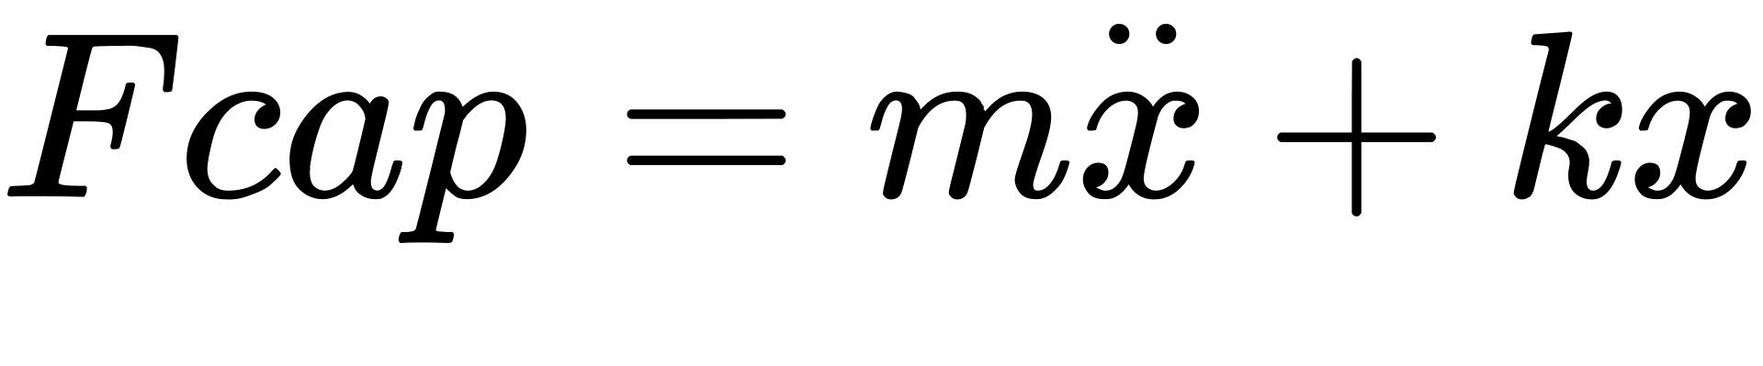
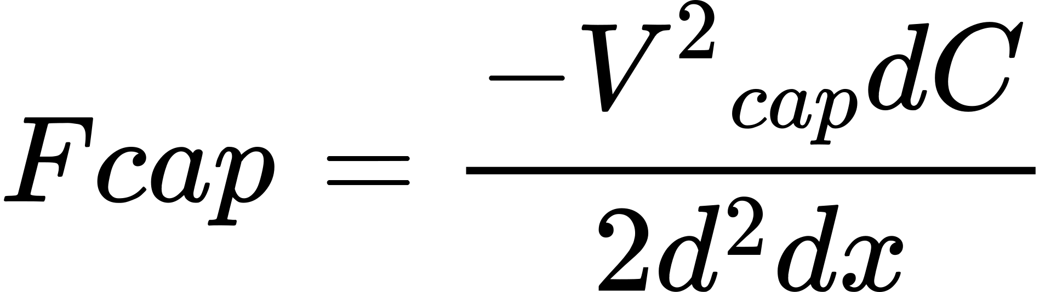
System Overview and System Calculations
A. Dynamic part
To create the equations of the dynamic part, we start by
finding the equation of motion of the capacitor. From Newton's
2nd law of motion, the equation of motion of the capacitor is
found as follows:
In Newton's 2nd law of motion b refers to the damping force.
Since the reference sheet states to ignore the damping force, the
equation of motion of the capacitor from Newton's 2nd law of
motion can be expressed as follows.
In the reference sheet the capacitor force (Fcap) is expressed as follows:

Slide 7
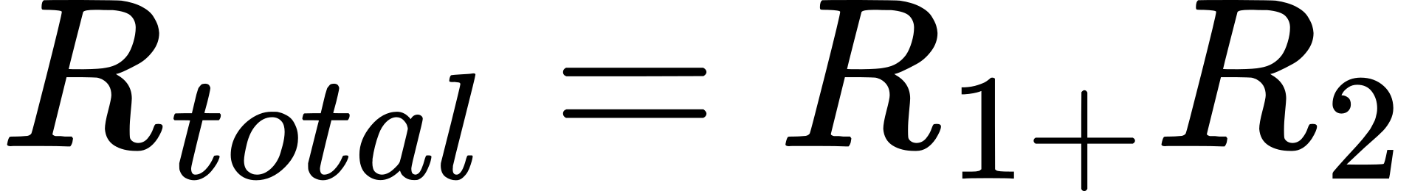


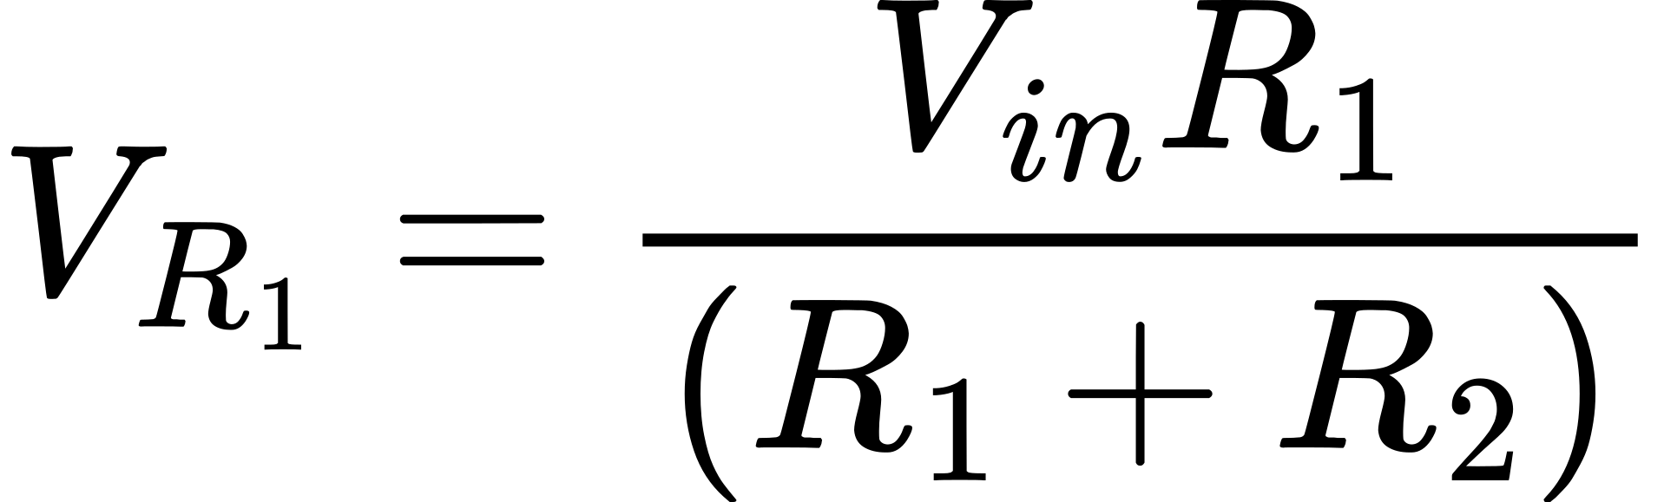
System Overview and System Calculations
Kirchhoff second law is used to find the capacitor voltage
(Vcap) in equation:
As can be seen from the voltage divider circuit in Figure 2, we
obtain the equation:
From Ohm's law and the voltage
divider principle, can be derived with the following
formula:

Slide 8
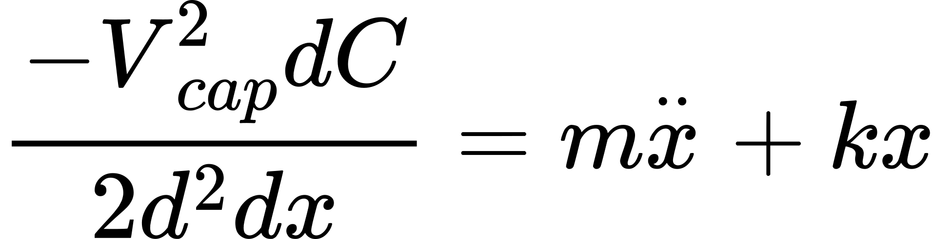

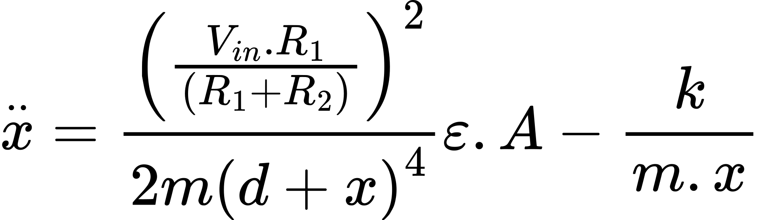
System Overview and System Calculations
Using the formula for the capacitor force (Fcap) given in the
reference sheet, we equate it to the formula obtained from Newton's 2nd law of motion.
Using this equation to find

Slide 9
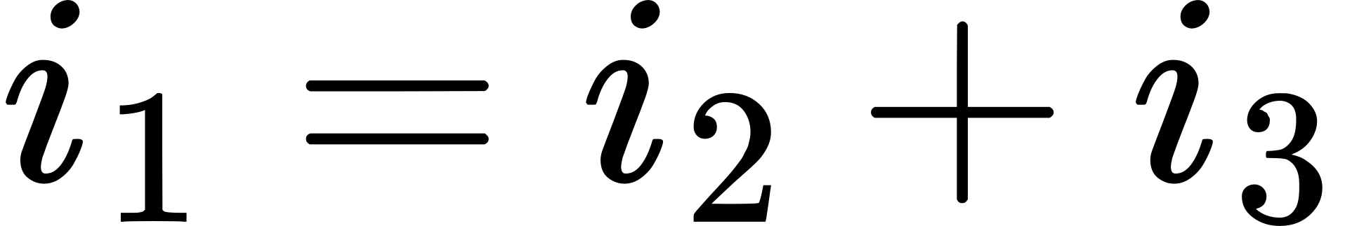
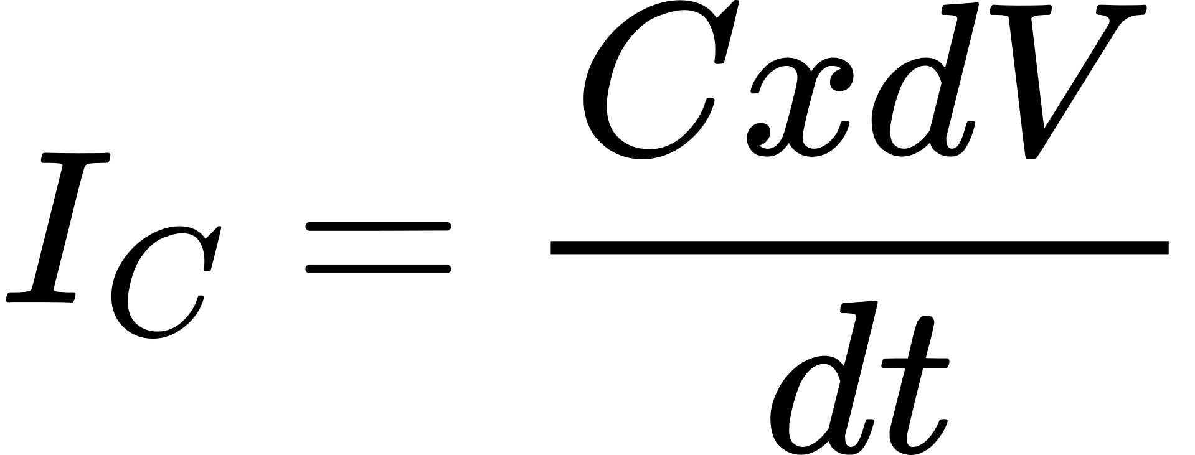
System Overview and System Calculations
B. Electrical Part
From Kirchhoff's Voltage Law, the voltage equation of the
capacitive motion system can be found:
From the nodal analysis according to the capacitive
displacement system, the equality of the currents i1, i2, i3 can
be provided as follows:
According to nodal analysis, the current passing through the capacitor Ic can be called I2.
Therefore, from now on, we will refer to Ic instead of I2 in the equation.
From the capacitor current equation, the equation of the current
flowing through the capacitor can be found as follows.

Slide 10
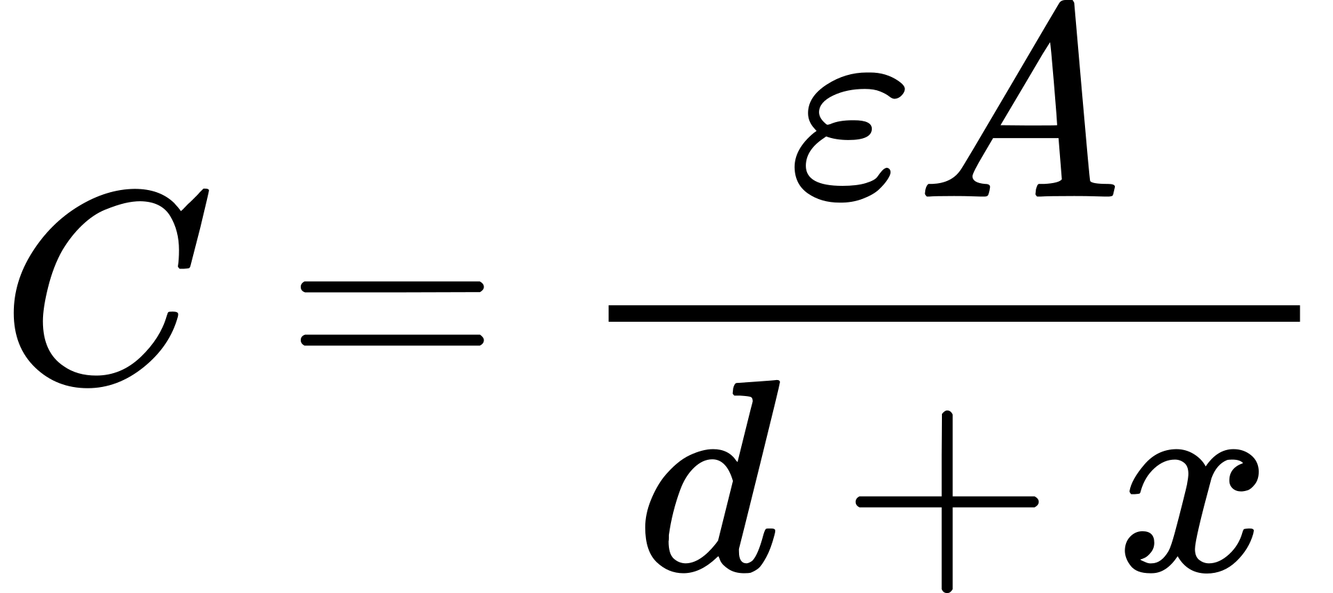
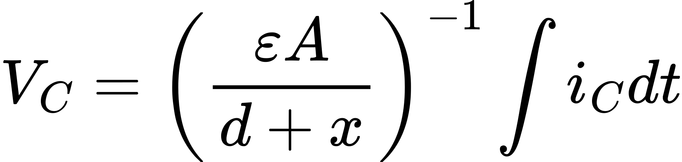
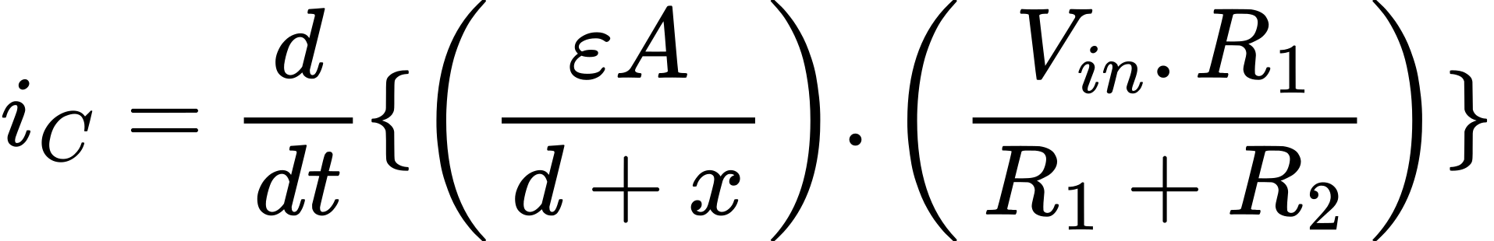
System Overview and System Calculations
The current through the capacitor equation and the capacitor
equation found when examining the equation of motion are
used to find the current through the capacitor. We recalculate
the Ic equation.
Again, we use Kirshof's voltage law and derive the voltage
analysis equation of the system.
Here are all the formulas we will use to simulate a capacitive
motion system. With these calculations we will be able to
measure how a capacitive motion system will behave.

Slide 11
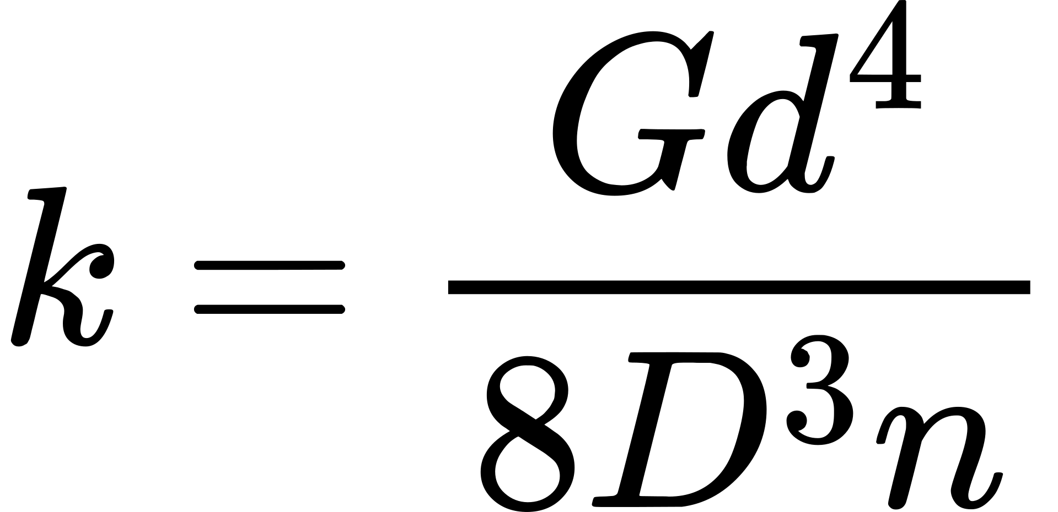

Parameters
A. Spring
Silicon and stainless steel are generally used in the spring. We
will use stainless steel for this system. Stainless Steel is widely
used in industry because of its higher hardness, good
mechanical properties, corrosion resistance.
Parameter | Value | Unit
G(Stainless steel) | 80 | GPa
d | 0.18 | m
D | 0.47 | m
n | 5 | n
With the given values we can find the spring constant. Spring
constant formula to find the spring constant:
B. Capacitor
We use the weight equation to calculate the plate weight of the
capacitor.
Parameter | Value | Unit
Material (Nickel) | 8912 | kg/m3
Thickness | 25 | μm
Area | 0.0001 | 𝑚2
C. R1, R2
The resistors in this system will be taken as R1 = 0.002, R2 = 0.001.
D. Vin
In capacitive displacement systems, V is usually taken
between 5 and 20. In this system, V will be taken as 12.

Slide 12
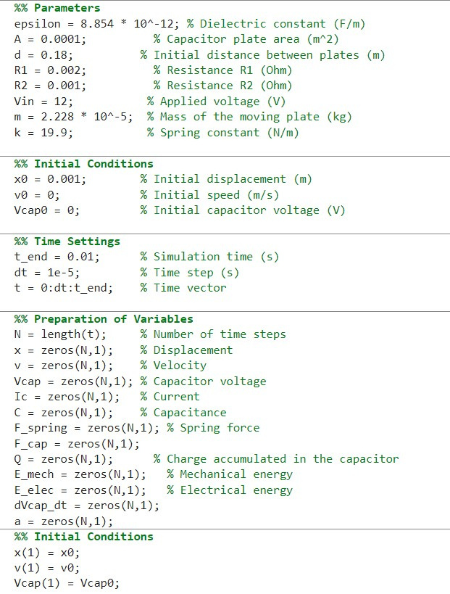
Simulation and Results
Initials

Slide 13
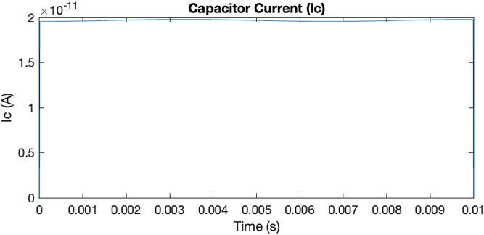
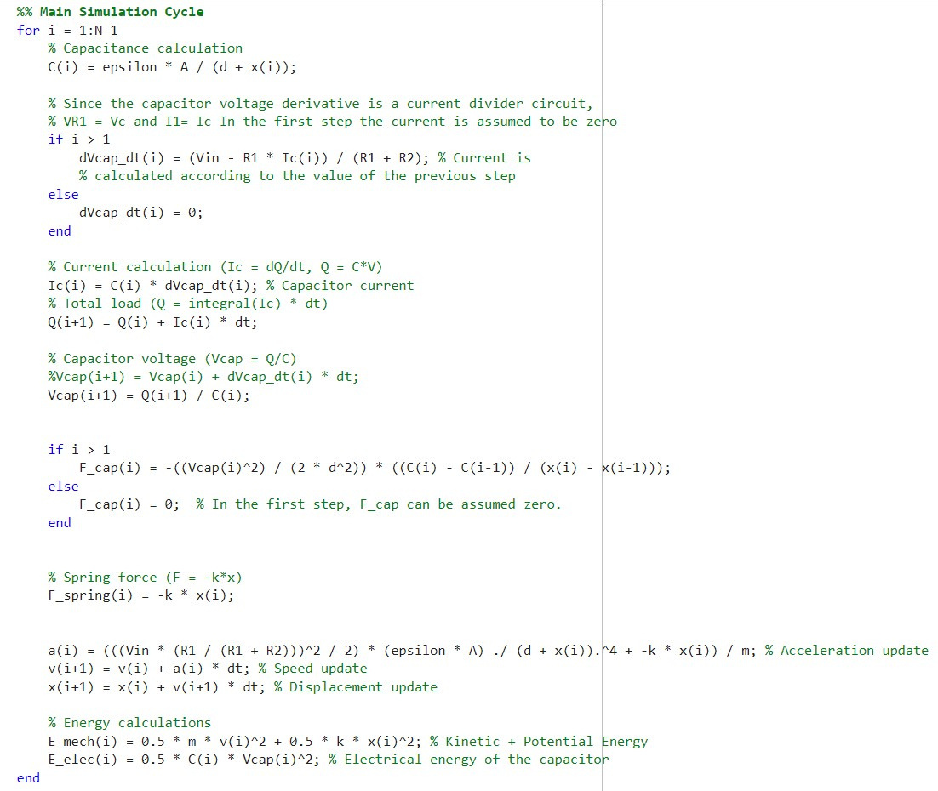
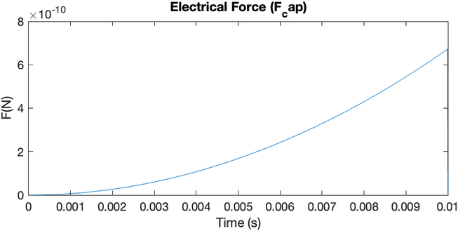
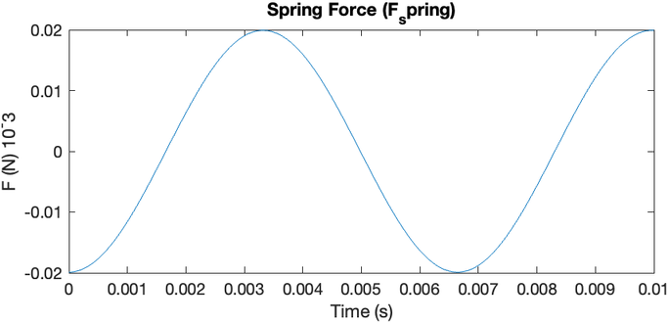
Simulation and Results

Slide 14
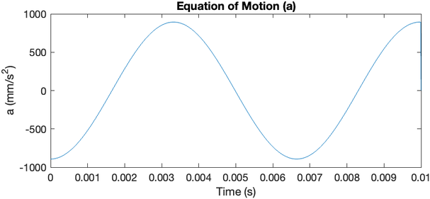
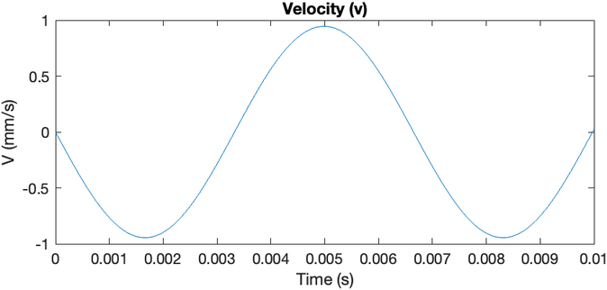
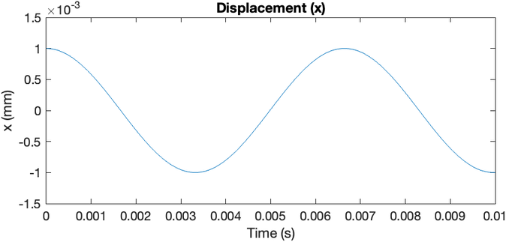
Simulation and Results

Slide 15
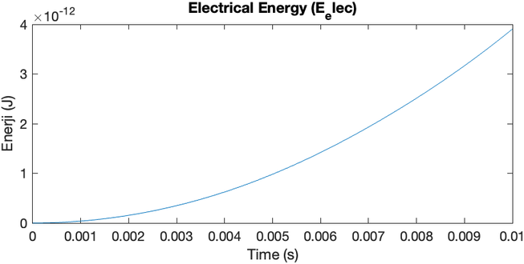
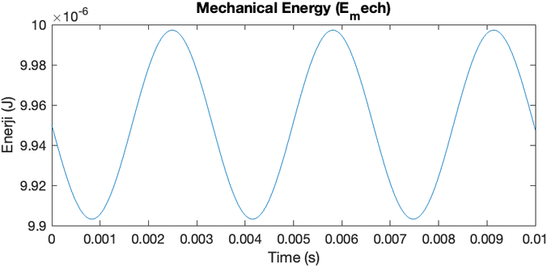
Simulation and Results

Slide 16
Thanks for listening
Questions ?

